Slide 1
Final Review Lab
Front-End Web Development

Slide 2
Lesson 16 Change Log FEWD 3.1 - 3.2
Below are the specific changes made in this lesson.
Returning Instructor Directions:
Click on the hyperlinks below, and it will direct you to the specific slide.
Copy the entire slide, and paste in your existing curriculum deck.
Pre-Class Materials and Preparation - Since this lesson no longer focuses on API, check out the Flex collection if you want to continue incorporating API-related activities.
Added the following CodePens to the new CodePen collection “Warmups”: Forms Warmup, Final Review Lab User Behavior Demo, Starter, Solution, To-Dos Only Solution, Solution with Local Storage, and Solution with Event Delegation.
Build a To-Do App (whole section) - Added a new review lab and moved API to flex.
Final Project Checkpoint - Added a discussion about final projects, including teaching tips and suggestions for customization.
Share how the lesson went through our Instructor Lesson Exit Ticket - the Curriculum Feedback form: http://ga.co/curriculum-feedback

Slide 3
Pre-Class Materials and Preparation
Review all slides, lab activities, and code-alongs.
There are prompts in the speaker notes with opportunities for instructor customization.
Materials:
Flex in CodePen
Warmups in CodePen

Slide 4
Final Review Lab
Overview
This lesson reviews the course content so far, allowing time for students to solidify the knowledge they've gained and ask necessary questions before moving further.
Learning Objectives
In this lesson, students will:
Apply CSS and JS skills to fit requirements of an assigned project.
Duration: 180 minutes

Slide 5
Suggested Agenda
Time | Activity | Purpose
0:00–0:30 | Q&A Review of JS So Far | There will likely be questions and a need for a review before jumping in to the review lab.
0:30–3:00 | Final Review Lab | Cumulative challenge bringing together all the concepts from the course to this point.

Slide 6
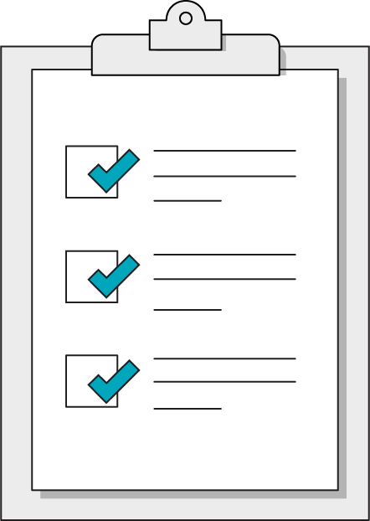
Today’s Learning Objectives
In this lesson, you will:
Apply CSS and JS skills to fit requirements of an assigned project.
‹#› | © 2020 General Assembly
Notes:
DURATION: 1 minute
TEACHING TIPS:
Learning objectives help frame the lesson and give students an idea of what to expect and focus on.
Explain to students how this lesson fits into the overall course to help them make connections with content from other lessons.

Slide 7
Build a To-Do App
Front-End Web Development

Slide 8
Build a To-Do App
120 minutes
Today, you’re going to build a to-do app. Users can add to-dos and mark to-dos as completed. We’ll be reviewing the following concepts while building this app:
Variables
DOM elements and event listeners
Arrays
Conditionals
Loops
Forms
Before we begin, let’s define our user behavior and demo the solution together.

Slide 9
User Behavior
The user can add to-dos by typing a to-do in the form input and then submitting the form.
When a to-do is added, an li element is added to the to-dos list element, and the to-dos count is updated on the page.
The user can “complete” to-dos by clicking a to-do li element. When a to-do is completed, it is removed from the left side list and added to the right side list. Both to-do counts should also be updated.
Demo:
https://codepen.io/GAmarketing/pen/mdROqWo

Slide 10
Build a To-Do App
Let’s break this lab into sections.
We’ll focus first work on just the to-dos and then progress to the completed to-dos later.
Starter code:
https://codepen.io/GAmarketing/pen/XWpNzae
Solution code:
https://codepen.io/GAmarketing/pen/ZELBaXK

Slide 11
The To-Do Functionality
Let’s break the to-do functionality (without completing to-dos) into the following steps:
Create our form submit event listener.
Do we need event.preventDefault() here?
Get user input.
Check if user typed anything
Add the to-do to the array.
What array method?
Render the to-do.
How can we add an li to a ul element?
Update the to-do count.
What array property?
To-dos only solution code:
https://codepen.io/GAmarketing/pen/ZELBaxJ

Slide 12
The Completed To-Dos
What about our completed to-dos? We have some similar functionality, but first we need to make sure the user can click and remove them from our left side list:
Create event listener for completing to-dos
When should it be added?
Remove to-do element from array
Repeat previous steps with completed to-dos (add to array, render HTML)
Re-render both to-do counts
Full solution code:
https://codepen.io/GAmarketing/pen/ZELBaXK

Slide 13
Bonus Prompts!
Try the following:
Use localStorage to store to-dos in browser so they persist between visits.
MDN - localStorage
Solution code with local storage
Rewrite “complete to-dos” function as one event listener when page loads.
Solution code with event delegation
Notes:
TEACHING TIPS:
If students are looking for additional practice, you can use the prompts and the solution code here.

Slide 14
Final Project Checkpoint
10 Minutes
Don’t wait until the last week to start working on your project!
Here are some questions for consideration:
How has your project evolved since the last checkpoint?
Is there another JS functionality you want to include?
What has been the most difficult part of your project?
If you had more time to work on the project, what might you add to it?
Notes:
TEACHING TIPS:
Students should make sure their final project idea is attainable in the time they have. If they’re unsure if an idea is too difficult, check with the instructional team — it may make sense to scale the MVP of the project down and save the idea as a nice-to-have.
Remind students that they can keep working on the project after the course ends as they keep learning and want to develop it as a portfolio piece!
Customize it! Edit this slide with the following:
Link to final project guidelines.
Add slide with milestones in a table.
Transfer the discussion questions to a Google form and share the link on the slide, so you will have a record of where students are with their final projects.

